Slide 1

Designing the Optimal Lineup in English Premier League Football
Derek Caramella & Miguel Novo Villar
02 December 2021

Slide 2
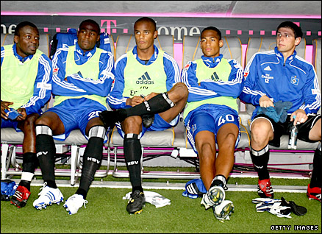
Why do Managers Care About Team Composition?
Wage Capital Scarcity
Transfer Windows & Deadlines
Dodging relegation is top priority
Who do I buy?
Who do I play?
What combination of player types perform successfully?

Slide 3
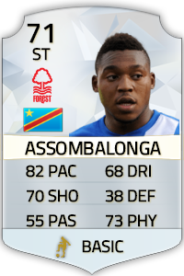
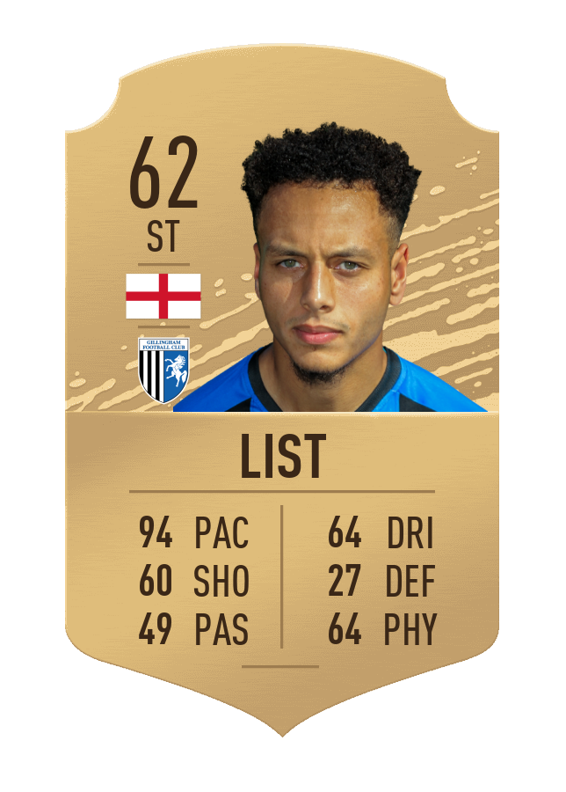
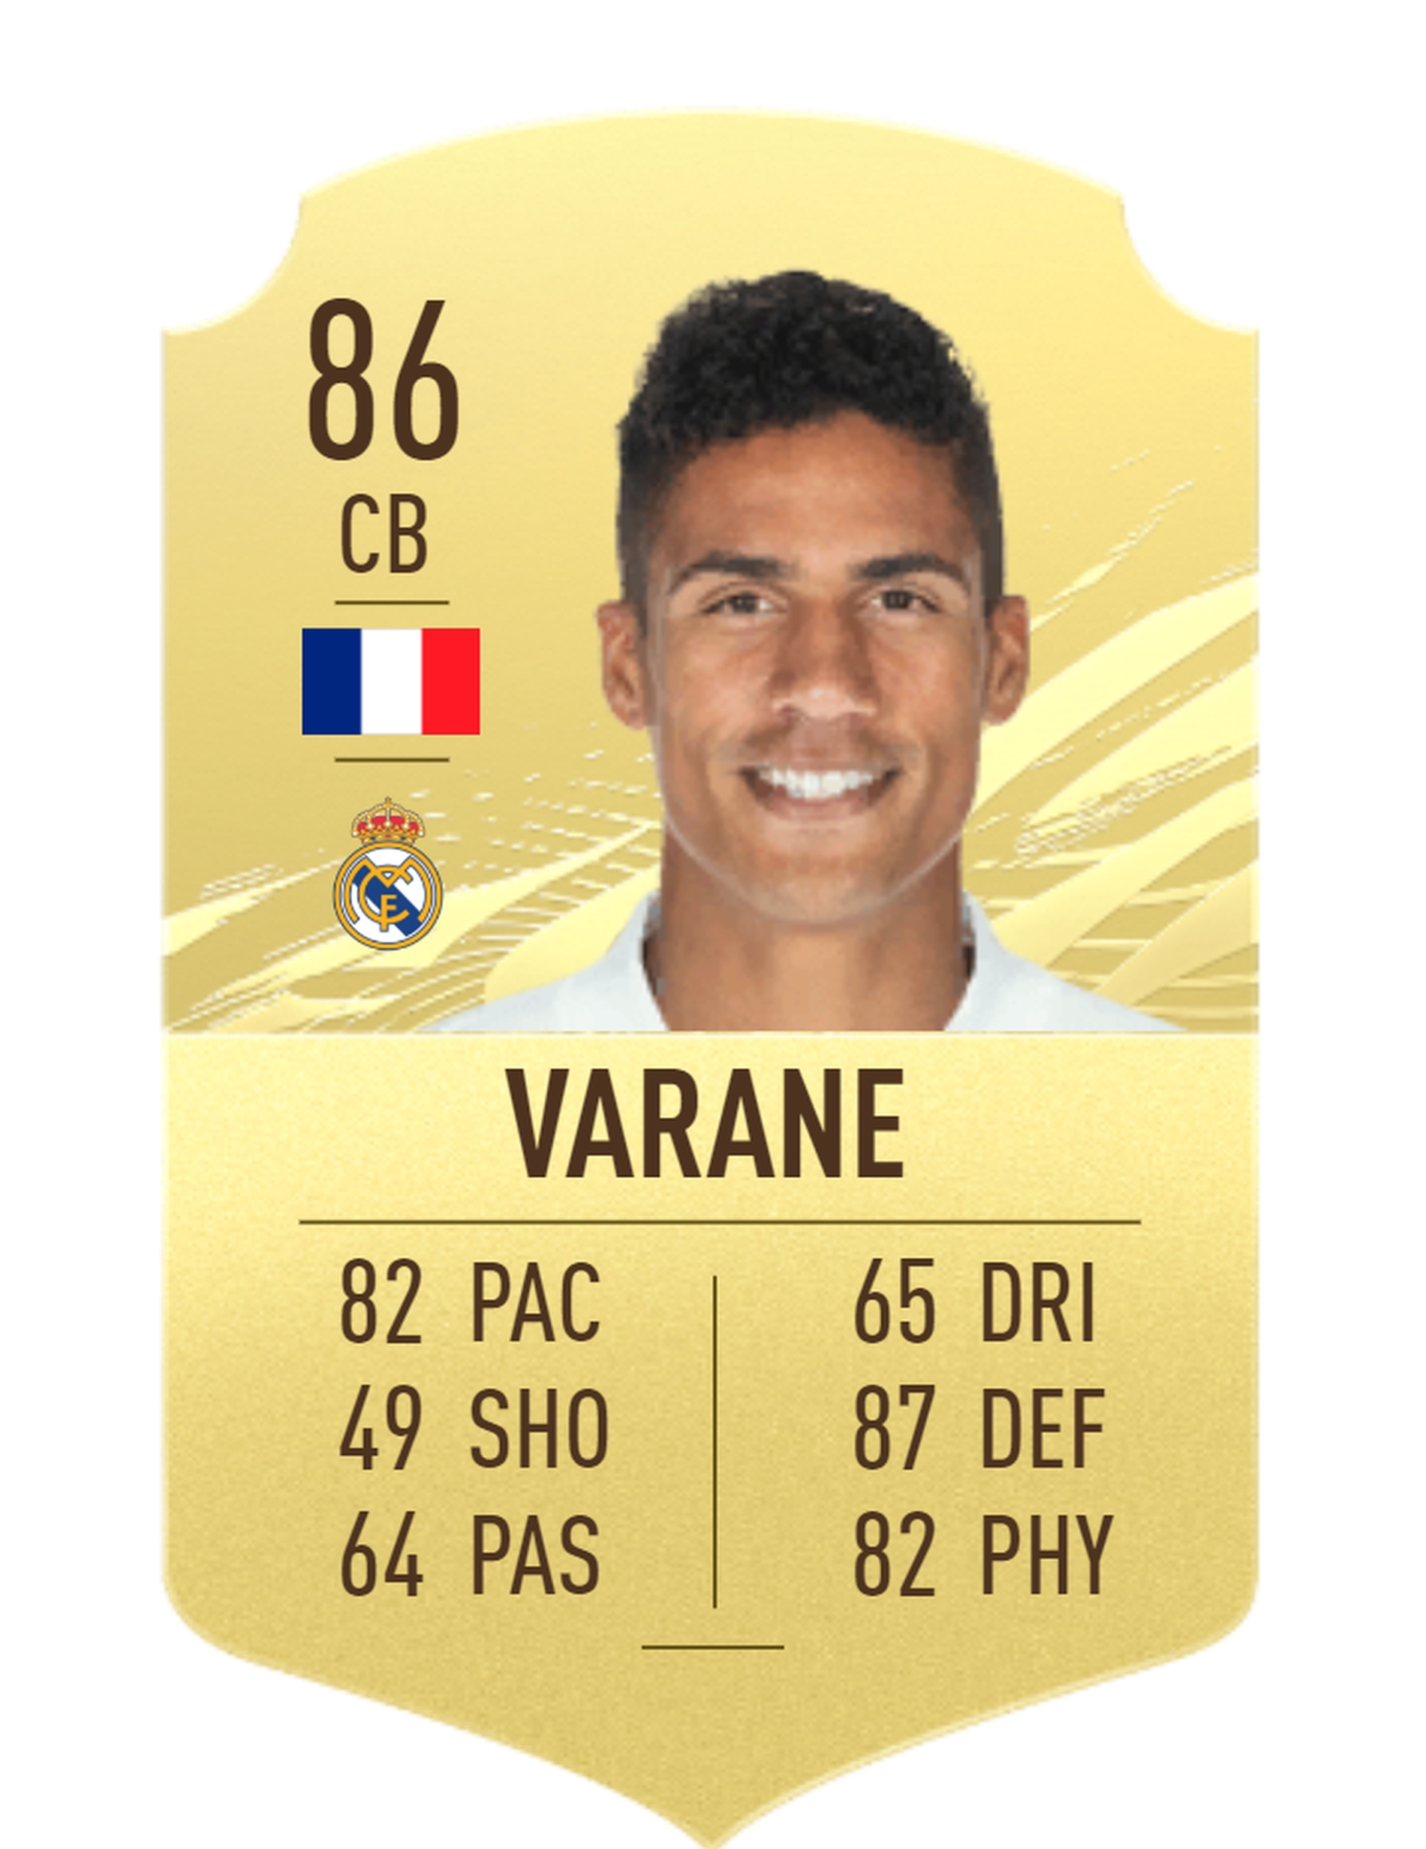
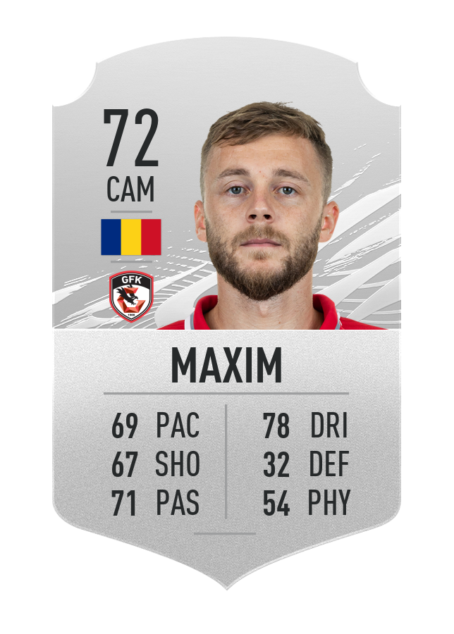
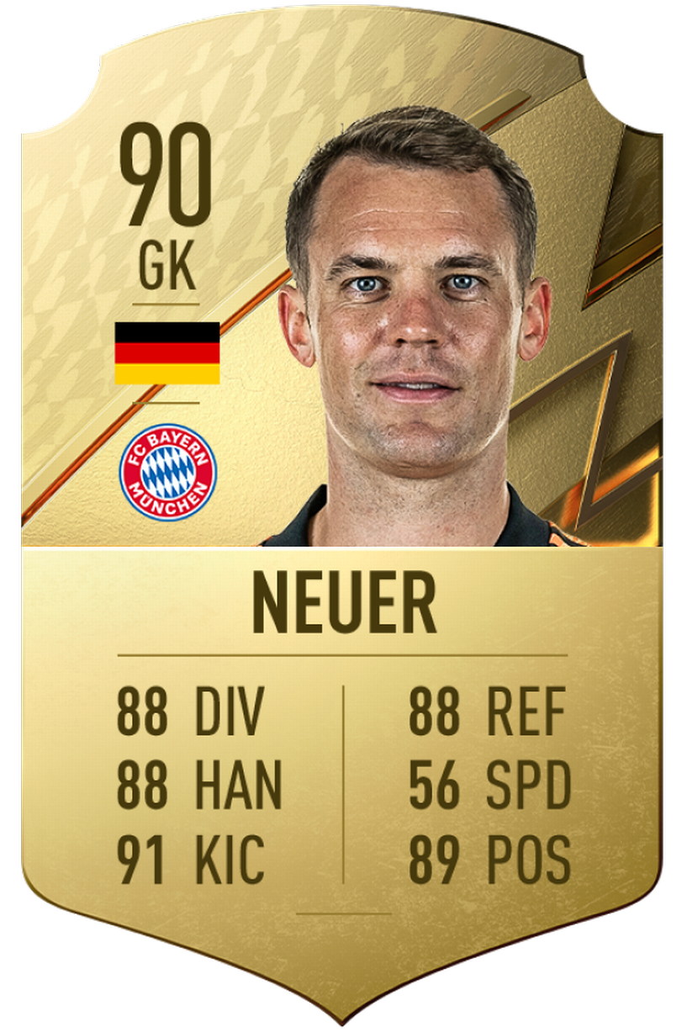
Why do Managers Care About Team Composition?
Wage Capital Scarcity
Transfer Windows & Deadlines
Dodging relegation is top priority
Who do I buy?
Who do I play?
What combination of player types perform successfully?

Slide 4
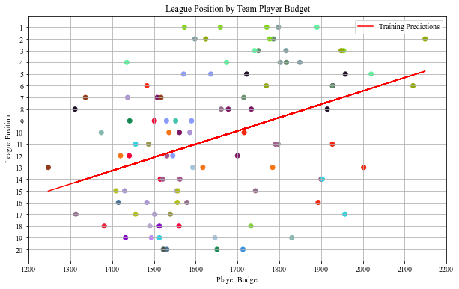
Does Money Impact League Position?
Yes
Ridge Regression
As wage capital expenses increase, a club, on average, performs better
From 2016-2017 to 2020-2021 season
Each color represents a team throughout the time interval

Slide 5
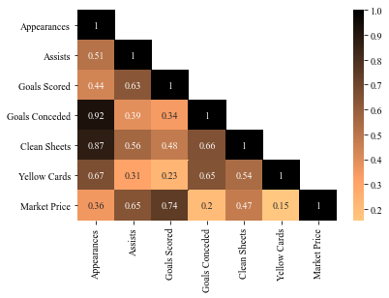
What Features Determine a Player Tier?
Market price correlated with assists & goals scored
Goals conceded, clean sheets, & yellow cards are correlated with appearances

Slide 6
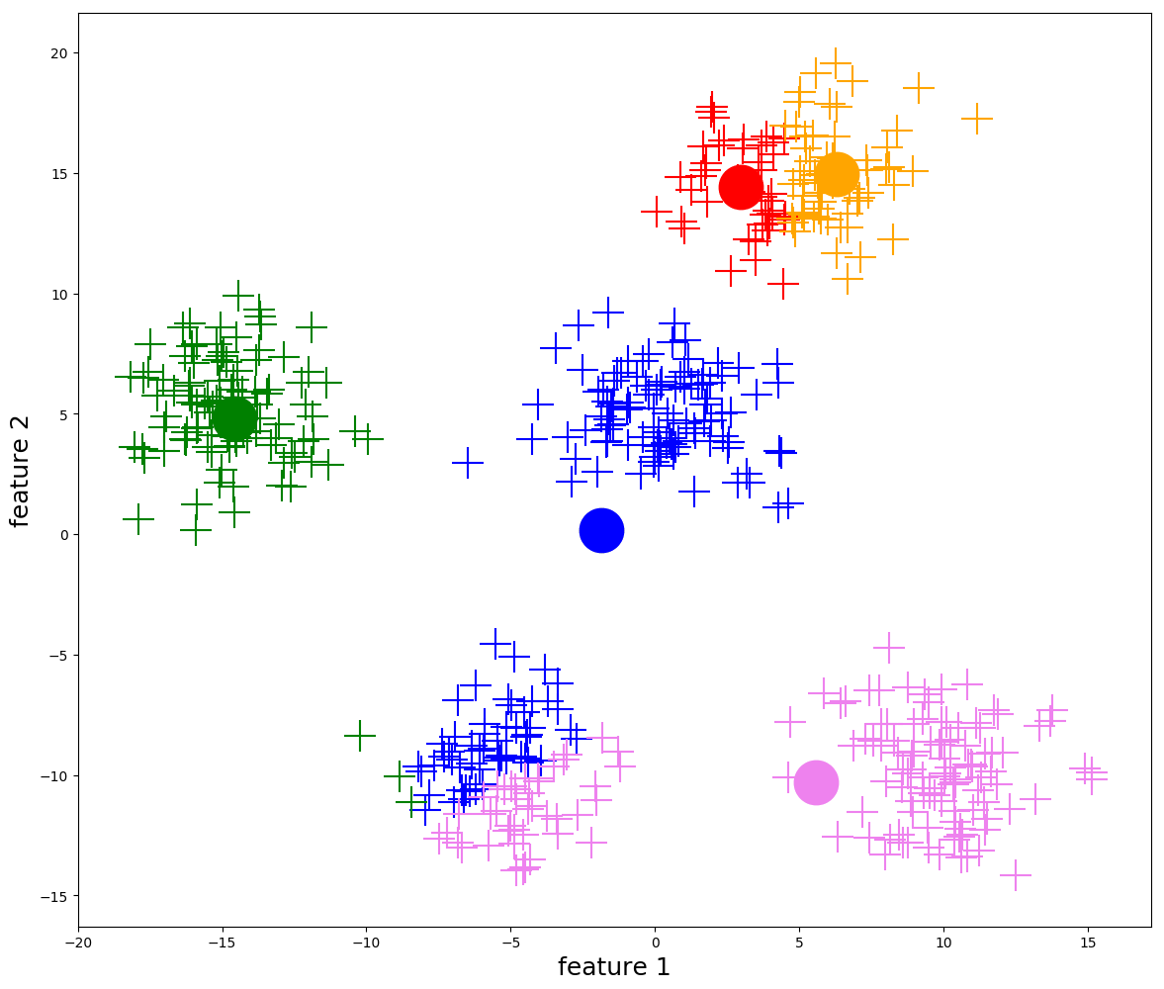

How to Identify Player Type?
K-means++ Clustering
Centroid Based Clustering
Initialize by choosing a random centroid, then identify other centroids by maximizing the distance between clusters
Iteratively calculate the mean of the cluster, then adjust the centroid until the mean is constant across iterations
Higher quality results: initialization dispersed across the domain relative to a randomized initialization of a vanilla k-means algorithm
Features:
Appearances
Assists
Goals scored
Goals conceded
Clean sheets
Yellow cards
Market Value
Three Clusters
Gold, Silver, & Bronze tiers

Slide 7
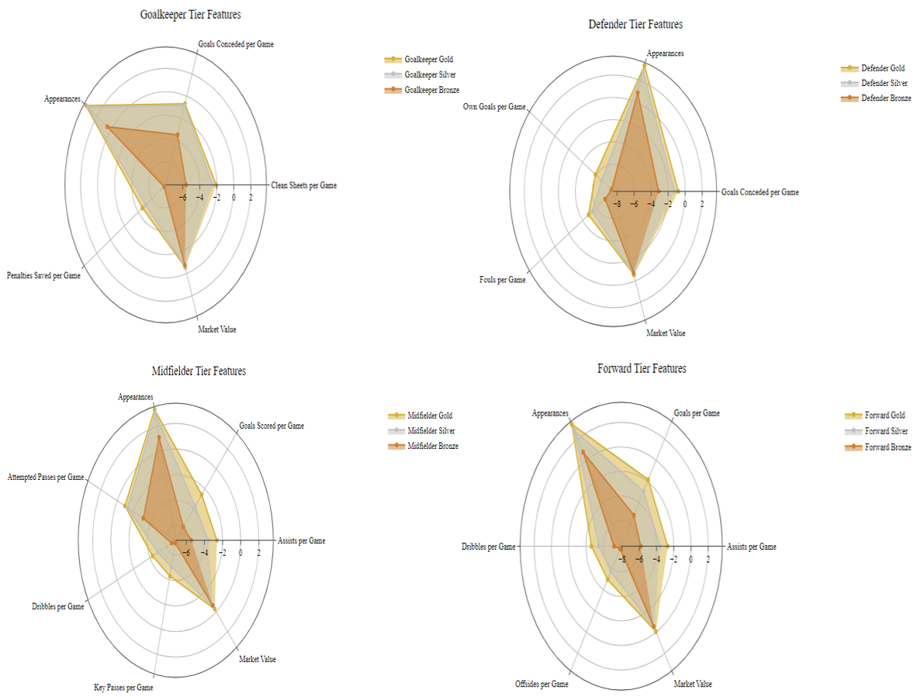
How to Correct for Season & Position?
Partition Data Set by Season
Game Progression
Off Season Transfers
League Bolstering
Partition Data Set by Position

Slide 8
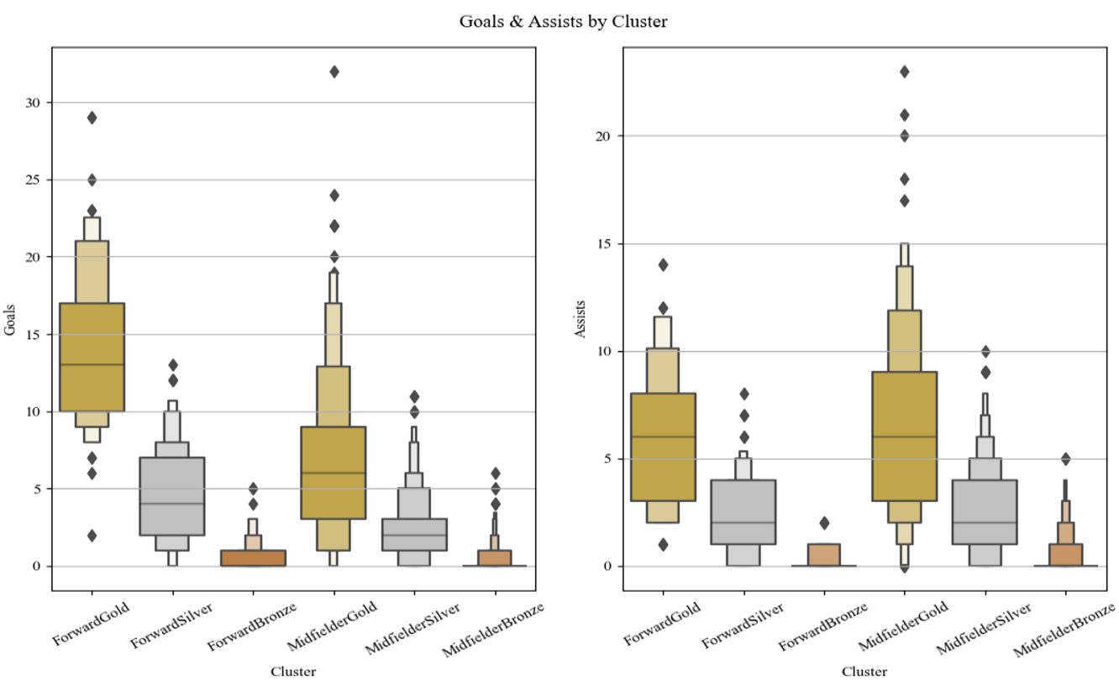
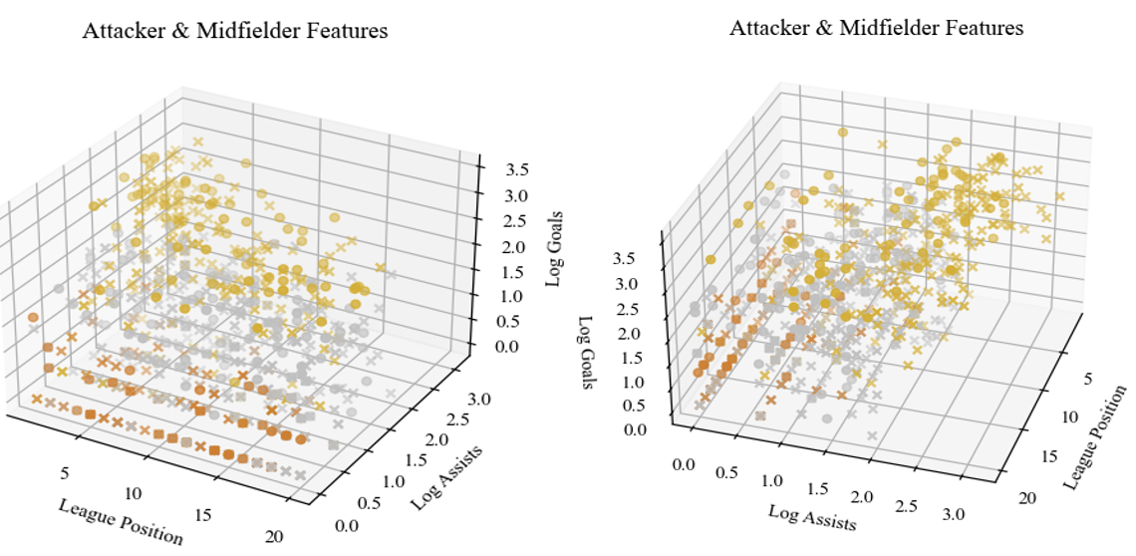
Are Forwards & Midfielders Similar?
x represents midfielders & o exhibits forwards
Key Findings:
Upper tier Gold Midfielder contribute the same expected goal count as a Gold Forward
Forwards rarely contribute the number of assists midfielders provide
All teams possess Bronze players regardless of league position

Slide 9
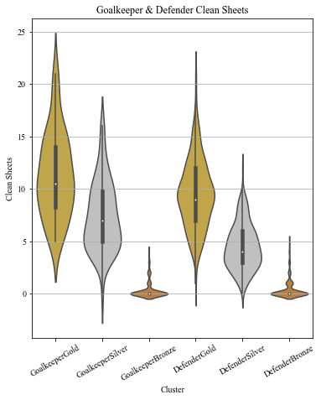
Are Goalkeepers & Defenders Similar?
Gold Goalkeepers outperform Gold Defenders
Gold Goalkeepers are scarcer than Gold Defenders
Silver Goalkeepers outperform Silver Defenders
Bronze Goalkeepers & Defenders contribute roughly congruent clean sheets

Slide 10
What Separates Top-Flight & Relegation Class Clubs?
Team Composition & Tactics
Frequent itemset analysis (Apriori) to identify frequent player combinations amongst Top-Flight clubs & Relegation Class Clubs
Project data set into two sets: The top 25% of teams & bottom 25% of teams
For each partition, consider each game week as a transaction
{GoalkeeperGold1, DefenderBronze1, DefenderSilver2, DefenderGold1, MidfielderGold4, MidfielderSilver3, ForwardGold2}
Top-Flight Clubs
{DefenderGold2, MidfielderGold1}
Relegation Class Clubs
{DefenderSilver1}
{DefenderGold1, MidfielderSilver1, MidfielderGold1}
{DefenderGold1, MidfielderSilver1, MidfielderGold2}
{DefenderGold1, MidfielderSilver2}
{MidfielderGold1, MidfielderSilver2}

Slide 11
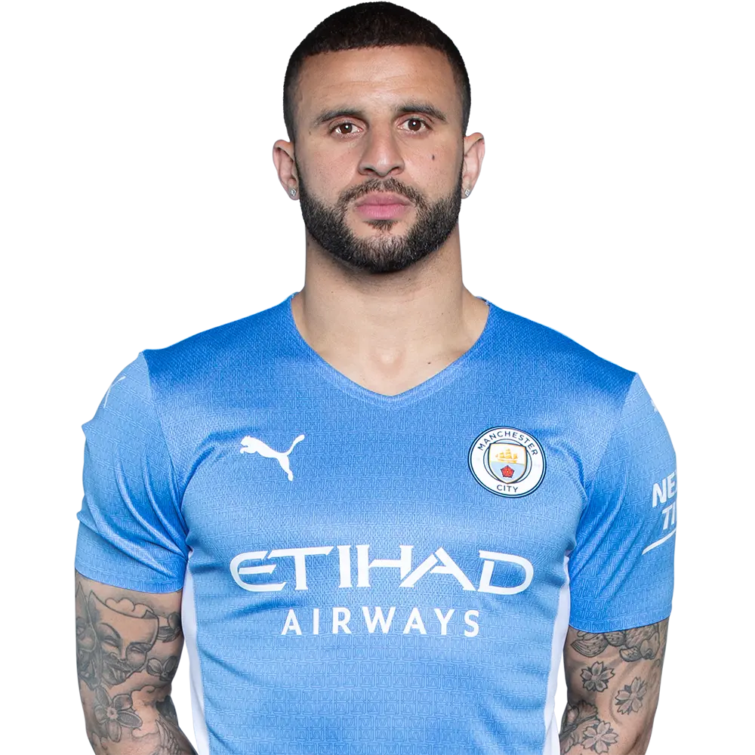
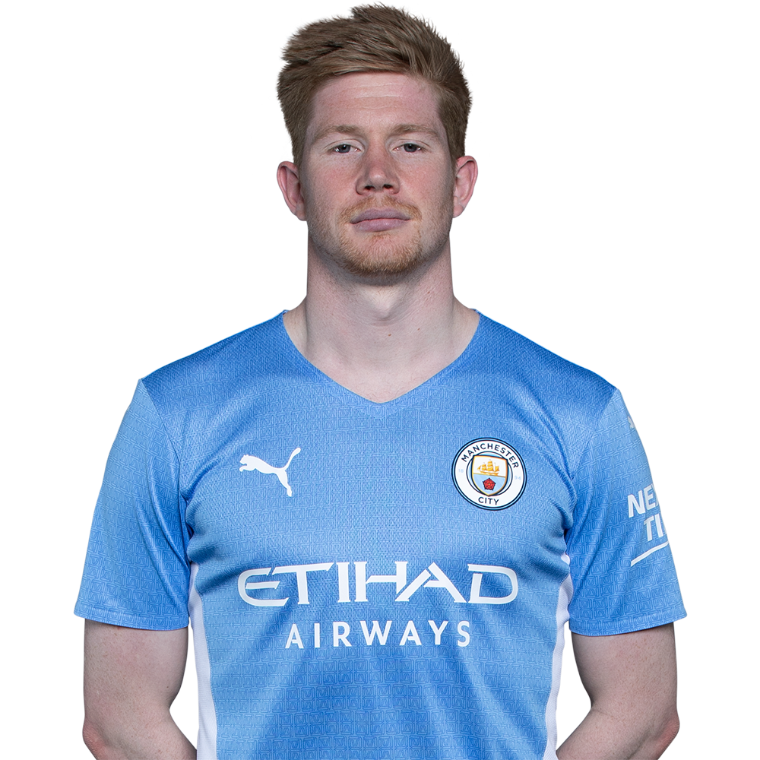
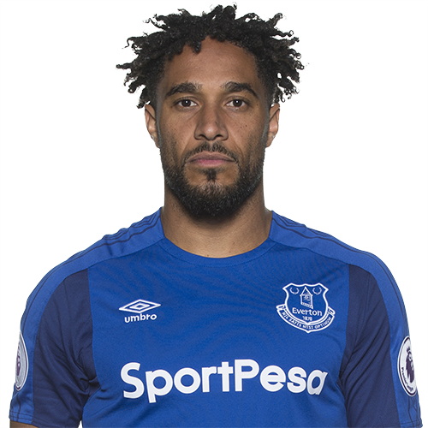
How Do Top-Flight & Relegation Clubs Play?
Top-Flight Clubs
Relegation Class Clubs
Offense transitions
Defense transitions
Establish offensive presence
Heavy emphasis on possession
Gold tier wingback defenders to maintain possession & deliver crosses
Gold tier midfielders to serve a strong, resilient forward
Establish defensive presence
Heavy emphasis on gold tier center back
Keep shots away from the middle
Attempt to score on counter attacks & mistakes

Slide 12
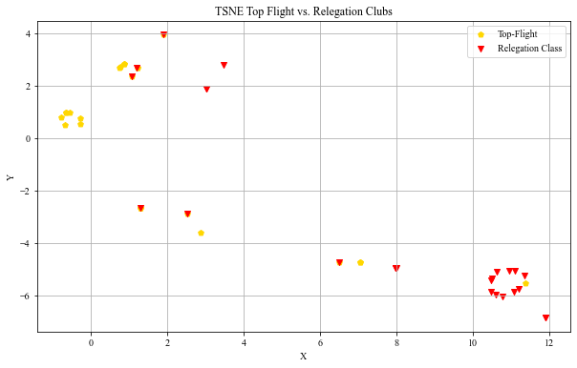
How Similar are Top-Flight & Relegation Class Clubs?
One-Hot Encoding
An array determining the frequent itemsets present in the club
T-SNE
t-Distributed Stochastic Neighborhood Embedding
Non-Linear Dimensionality Reduction
Preserve Local Structure
Handles Outliers
Results
Two distinct groups containing Top-Flight and Relegation Class clubs
Sporadic relegation class clusters
Sometimes Relegation Class clubs contain the correct player type combinations, but cannot get it done

Slide 13

What are the Key Points?
Invest in a strong gold tiered midfield accompanied by at least one strong wing back
Tactically focus on transitional moments relative to establishing defense
Above average Gold Midfielders score the expected value of Gold Forwards & provide more assists
Gold Midfielders reap the highest return on capital investment
Ensure tactics conform to the player combinations to generate fortunate results

Slide 14

What’s Next?
Similar analysis with La Liga
Various formations with frequent itemsets
Possession & passing decision during attack buildup

Slide 15

Questions?

